Slide 1

Uber Trip Data Analysis
N.Abhiram Chowdary
RA2211026050014
CSE AIML

Slide 2
Introduction
Uber is a global leader in ride-hailing services connecting millions daily.
Each trip generates key data points — time, fare, distance, duration, payment type, and location.
Analyzing this data helps:
Understand customer demand patterns.
Optimize driver availability and pricing.
Improve operational efficiency.
Power BI converts this raw trip data into actionable business intelligence.

Slide 3

Problem Statement
Business Requirement:
To analyze Uber trip data using Power BI to uncover insights into bookings, revenue, distance, time, and demand variations.
Key Needs:
Identify patterns in ride bookings and customer behavior.
Compare performance by time, day, and location.
Visualize trends to aid data-driven decisions for pricing and operations.

Slide 4
Objectives
Track KPIs such as Total Bookings, Total Revenue, Avg Booking Value, Distance, Duration.
Analyze trip efficiency in terms of travel distance and time.
Understand demand variation across time, day, and region.
Enable interactive dashboards for stakeholders.
Support strategic planning for fleet distribution, surge pricing, and city expansion.

Slide 5
Methodology / Implementation Overview
Data Collection:
Uber Trip Details.xlsx and Location Table.xlsx.
Data Cleaning (Power Query):
Removed duplicates and null entries.
Corrected date-time formatting.
Replaced missing payment types with mode values.
Data Modeling:
Created star schema linking Fact (Trip) and Dimension (Location, Vehicle, Date).
Calculated Columns and DAX Measures:
Total Bookings = COUNTROWS(TripDetails)
Total Revenue = SUM(FareAmount)
Avg Trip Distance = AVERAGE(Distance)
Avg Trip Duration = AVERAGE(Duration)
Dashboard Design:
Implemented dynamic measure selector, slicers, bookmarks, and conditional formatting.

Slide 6
Dashboard 1: Overview Analysis
Purpose:
To provide a holistic view of Uber’s operational and financial performance.
Key KPIs:
Total Bookings: 103.7K
Total Revenue: $1.6M
Avg Booking Value: $15
Total Distance: 349K miles
Avg Trip Duration: 16 mins
Visuals: KPI Cards, Pie Charts (Payment Type, Trip Type), Matrix (Vehicle Type).
Insight:
Uber Pay = 67% of payments (preferred digital method).
Day Trips dominate (73%), indicating high daytime mobility.
UberX generates max revenue; Hatchbacks dominate trip count.

Slide 7
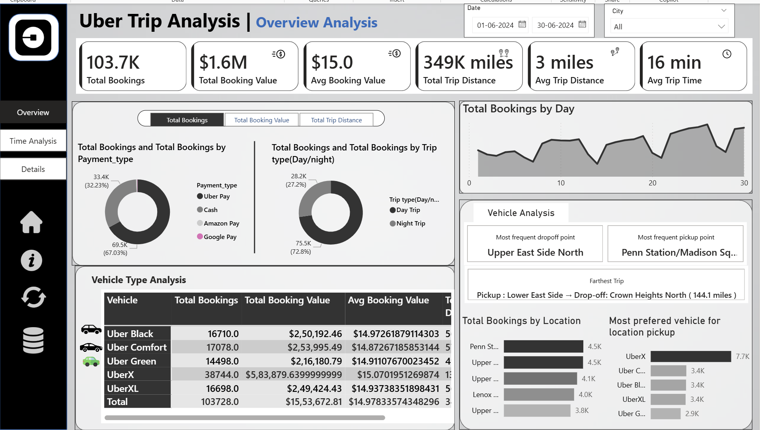

Slide 8
Dashboard 2: Time Analysis
Purpose: Identify booking trends based on time and day.
Visuals:
Area Chart (10-min intervals)
Line Chart (Day of Week)
Heatmap (Hour vs Day)
Insights:
Peak demand: 6 AM – 9 PM, especially during commute hours.
Weekends show higher average ride durations.
Early morning and late-night dips reflect driver unavailability gaps.
Enables time-based surge pricing and driver shift planning.

Slide 9
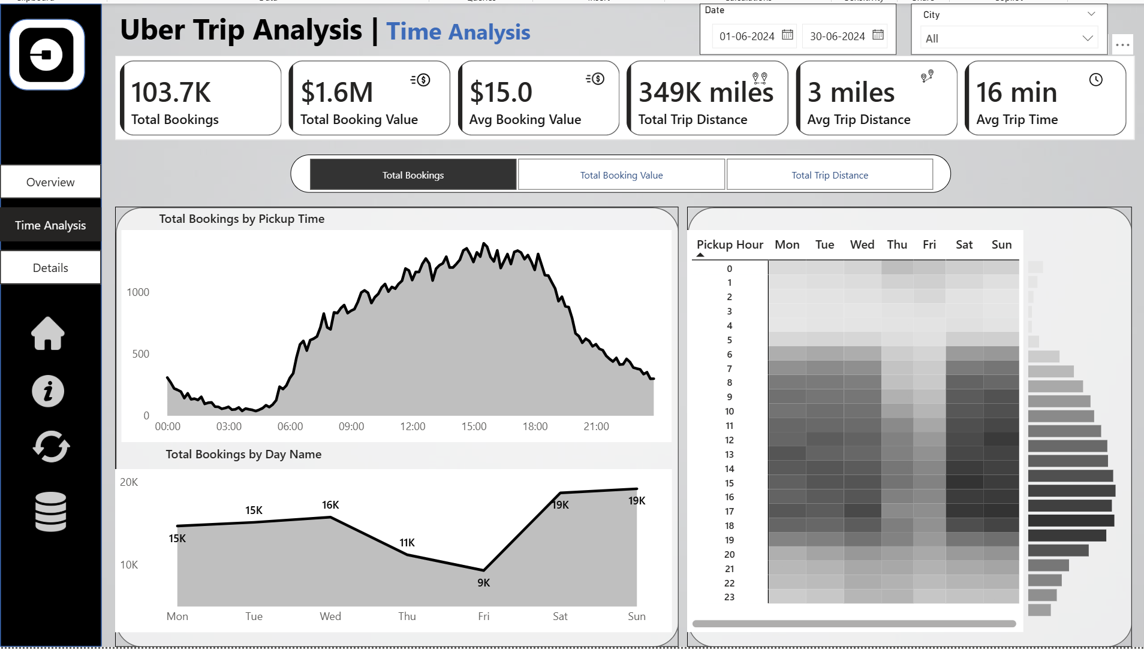

Slide 10
Dashboard 3: Location Analysis
Purpose: Identify top-performing areas and optimize driver distribution.
Visuals:
Map and Bar Charts for Pickup/Drop-off points.
Matrix for Vehicle Type preference by location.
Insights:
Top Pickup: Penn Station / Madison Sq. West
Top Drop-off: Upper East Side North
Farthest Trip: Lower East Side → Crown Heights North (144.1 miles)
Preferred Vehicle: SUV at airports; Hatchbacks in city centers.
Location-based marketing and targeted promotions recommended.

Slide 11
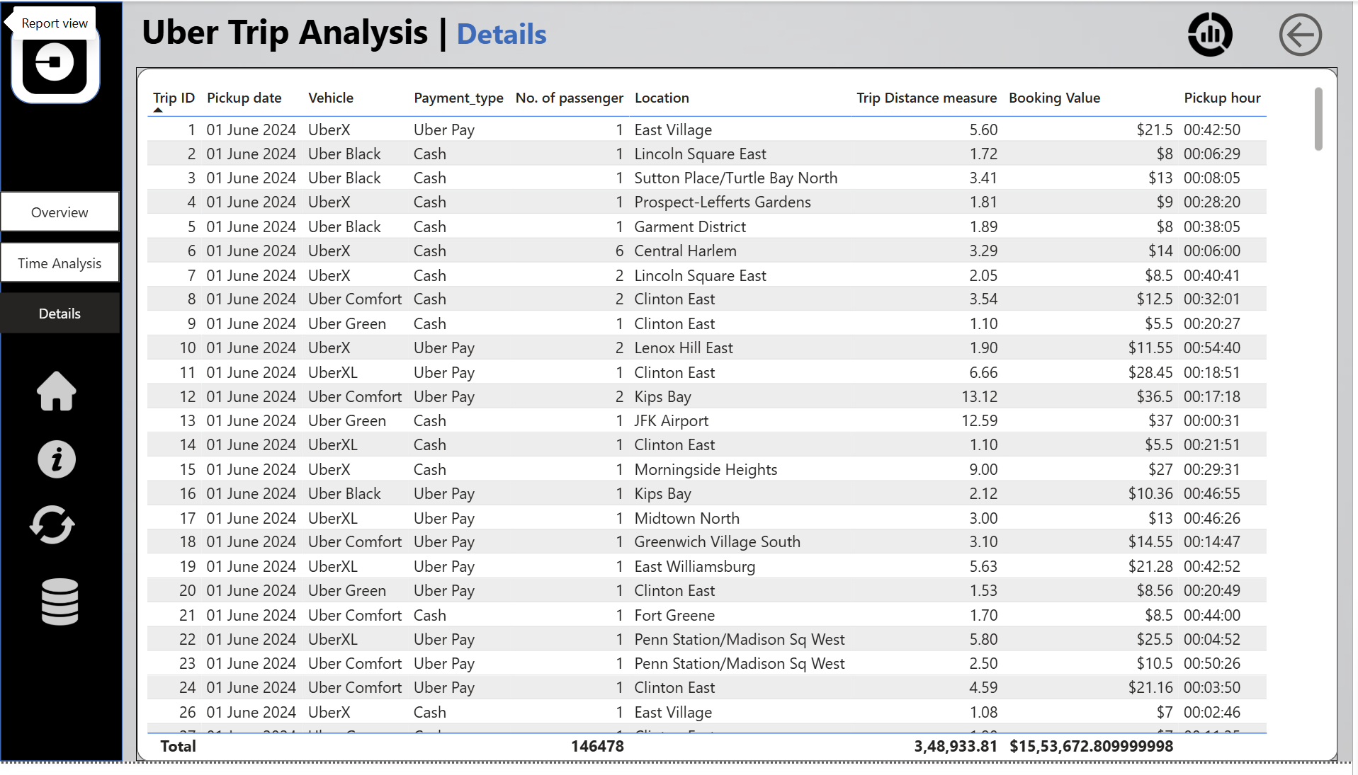

Slide 12
Business Impact
Improved Demand Forecasting:
Real-time analysis predicts high-demand zones and times.
Optimized Driver Allocation:
Helps reduce idle time and improve trip matching.
Enhanced Pricing Models:
Surge pricing implemented during demand spikes.
Revenue Growth:
Increased efficiency and customer retention lead to better margins.
Customer Satisfaction:
Lower wait times and faster rides through predictive driver placement.

Slide 13
Decision Support & Recommendations
Decision Support:
Power BI dashboards empower Uber managers with data-driven insights.
Support in real-time decision-making for fleet operations, pricing, and promotions.
Recommendations:
Use predictive analytics for driver scheduling.
Increase drivers in top 5 demand zones (airports, business hubs).
Promote digital payments (Uber Wallet, Card).
Offer targeted discounts during low-demand hours.
Expand SUV availability near high-income zones.

Slide 14
Conclusion
The Uber Trip Data Analysis provided valuable insights into ride patterns, customer preferences, and operational efficiency. By examining booking trends, revenue, trip durations, and travel distances, clear patterns emerged that highlight when and where demand is highest. The study demonstrated how data-driven analysis can help improve driver allocation, reduce idle time, and enhance pricing strategies during peak hours. Understanding location-based and time-based demand allows for better planning and resource management. The analysis also revealed customer payment preferences and vehicle-type trends that can guide service improvements. Overall, this case study proves that systematic data interpretation leads to informed business decisions, optimized operations, and greater customer satisfaction.

Slide 15
Future Scope
AI-Based Demand Prediction:
Use machine learning models to forecast ride demand across different times and locations for better planning and driver allocation.
Real-Time Data Monitoring:
Implement live dashboards to track ongoing trips, detect anomalies, and adjust resources dynamically.
Multi-City Expansion Analysis:
Extend the study to multiple cities to compare performance, identify regional trends, and support expansion strategies.
Integration of External Factors:
Incorporate data like weather, events, and holidays to understand their impact on bookings and optimize pricing strategies.
Driver and Customer Behavior Insights:
Analyze driver efficiency, customer preferences, and feedback to improve service quality and satisfaction.

